Slide 1

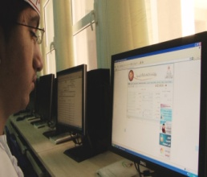

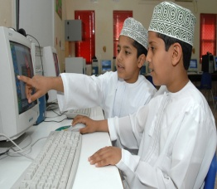
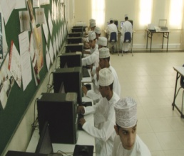
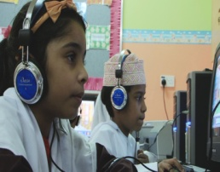

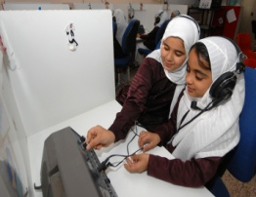
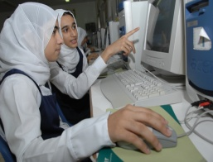
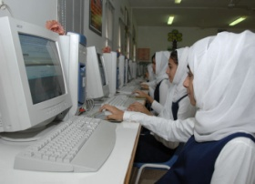
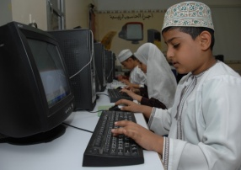
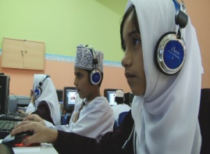
Educational Portal|Better Education – A Shiny Oman
www.moe.gov.om

Slide 2

Educational Portal|Table of Content
Section 1
Initiative Objective
Section 2
Time & Cost Benefit
Section 3
Security, Availability & Support
Section 4
Educational Portal & Society
Section 5
Accolades

Slide 3
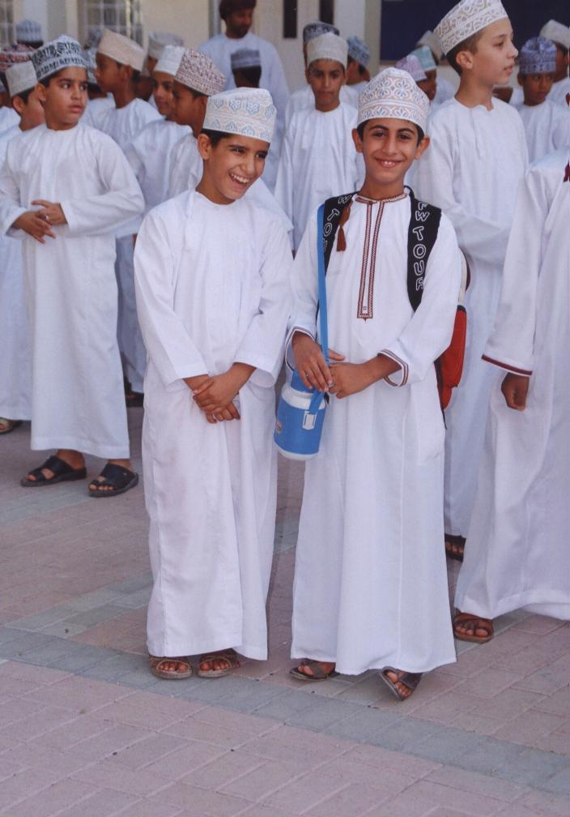
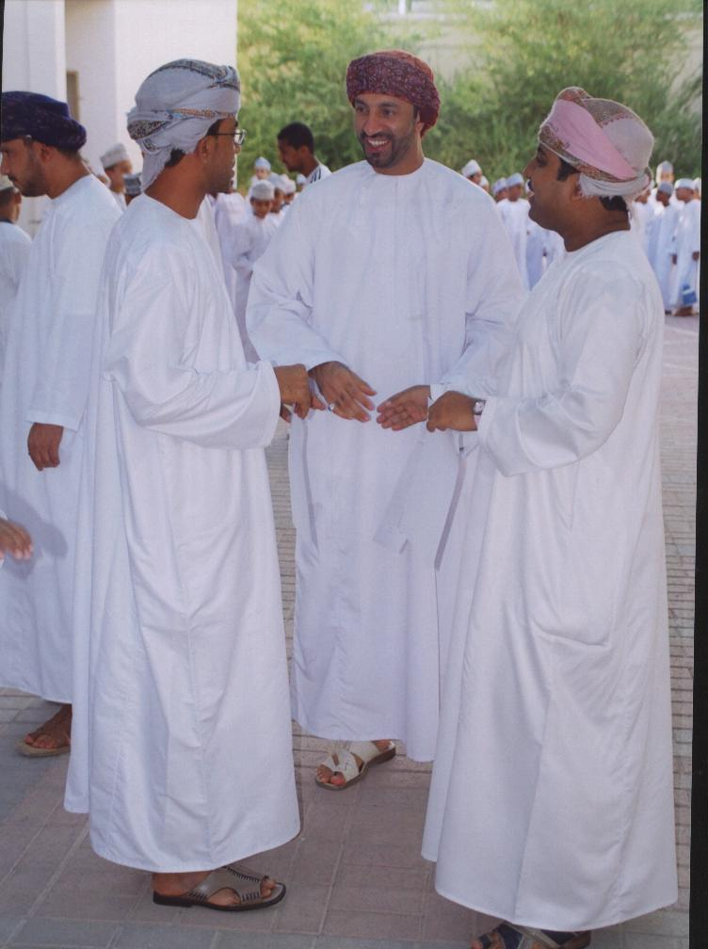
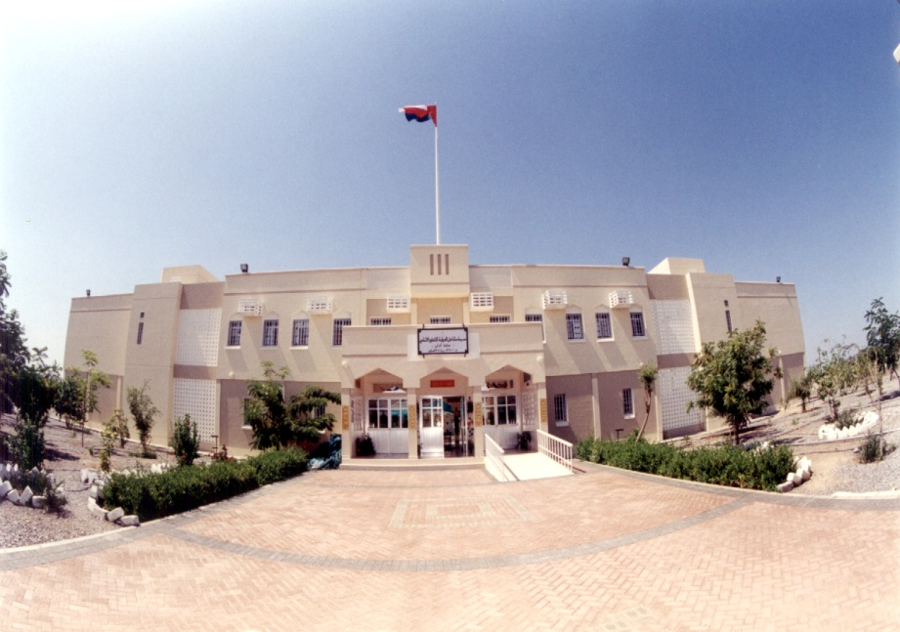
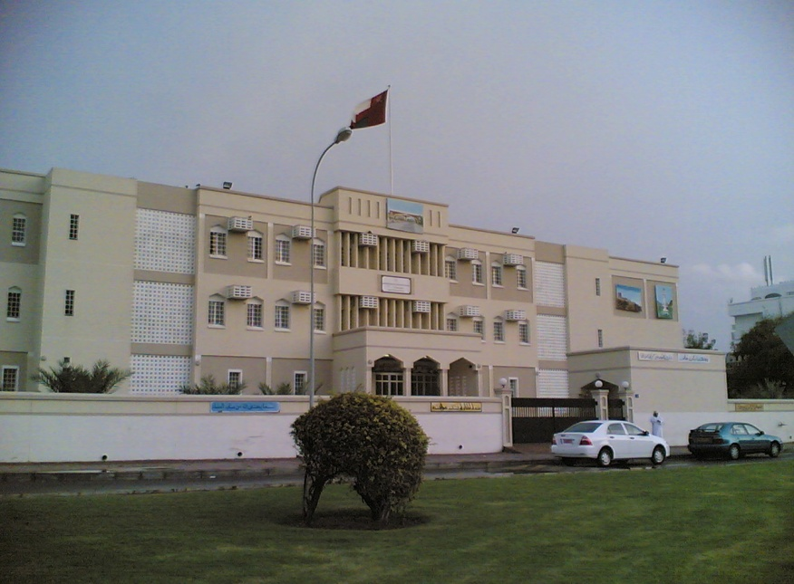
Education1-12
(General + Basic)
11 educational zones
1040 schools
53000 teachers
550000 students

Slide 4
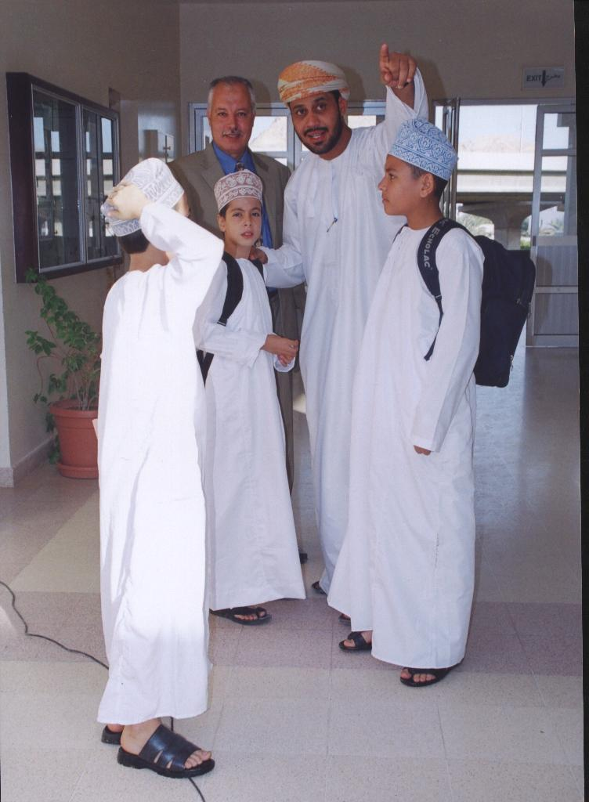
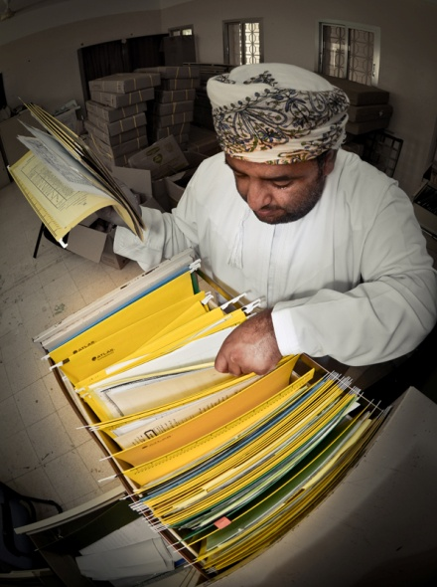

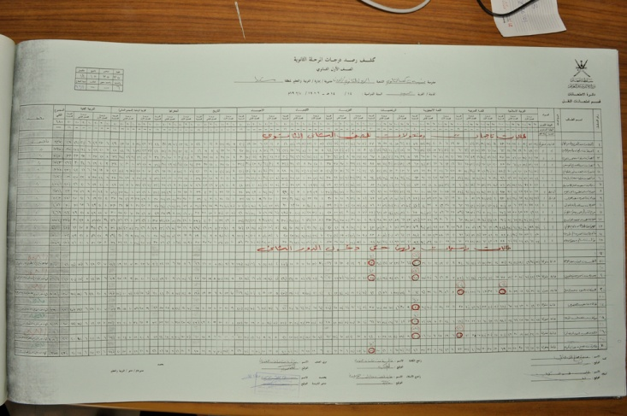
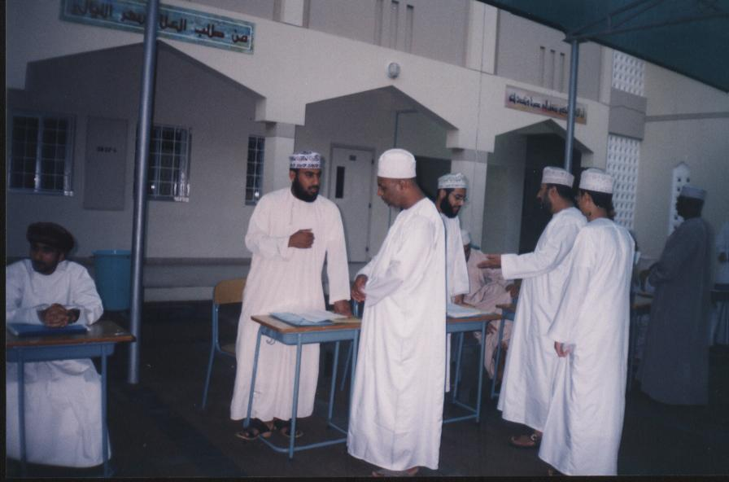

Traditional Student life Cycle

Slide 5

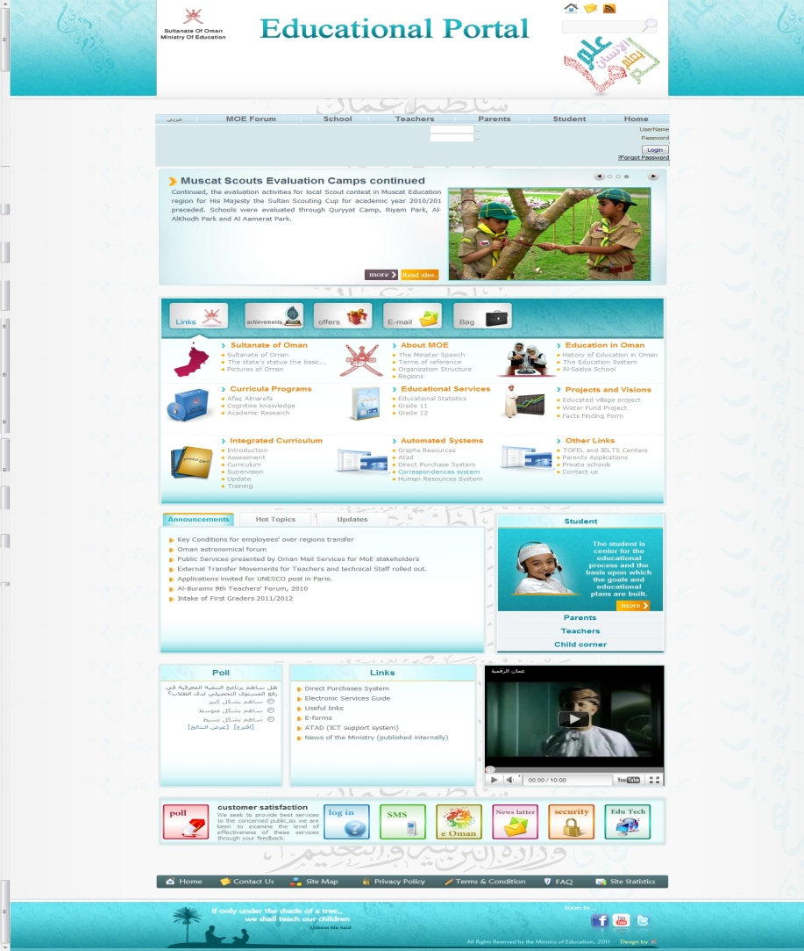



Educational Portal|Initiative Objective
Initiative Objective – Capturing Student Life Cycle
Section 1
Examination
Section 2
Table of Content
Attendance
Results
Parents
Educational Portal
Section 3
Admission
Performance
Student
Promote to Higher Education
Transfer
Section 4
www.moe.gov.om
Interactive Virtual Classroom
Certificates
Section 5
e-Library
Teacher

Slide 6
Educational Portal|Initiative Objective
Interface Portal System
A gateway which gives the opportunity for everyone to exploit the available services
Educational Portal: Components
IPS
SMS
DMS
E-content
LMS
Learning Management System
School Management System
Interactive e-content
Document Management System
Mange and archive the correspondences electronically, provide high quality of services
Add new effective learning methods and enhance distance learning

Slide 7
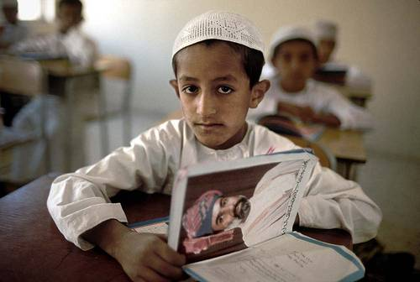


Educational Portal|Initiative Objective
Educational Portal: Available Anywhere Anytime
Helping our future for a brighter and shiny Oman…
The Educational Portal is an end-to-end e-service initiative that:
Captures the complete student life cycle starting from admission to school pass-out.
Enables parents to get critical information on their child’s performance, attendance and results for appropriate decision making.
Provides the Ministry with appropriate statistical data for planning and prioritizing initiatives.
New dimension of modern education - Virtual Classroom, emails, chat, blogging…
Services through multiple channel ensures a better and anytime anywhere availability….

Slide 8
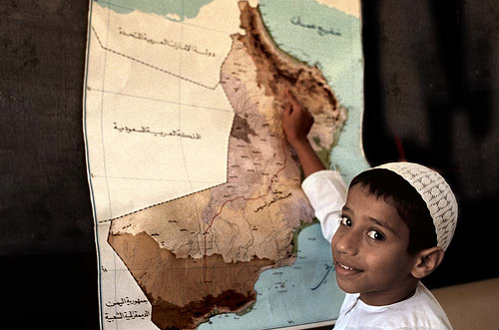
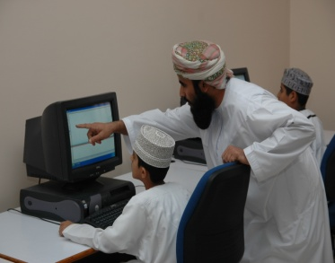

Educational Portal|Initiative Objective
Working in silos …The geographical spread demanded better coordination…
Educational Portal: Why we started?
Difficult to manage and co-ordinate 11 educational zones, 1040 schools, 53000 teachers and 550000 students.
Challenge in exchanging knowledge, thoughts, experiences and skills as each institution is geographically away from each other.
Redundant and time consuming processes and paper based communication/record maintenance.
Minimal involvement from parents and other key stakeholders.
No statistical data for school drop-out, Teacher-Pupil, Male-Female, Class-Student ratio…
Difficult to store, maintain and retrieve from manual data ….

Slide 9





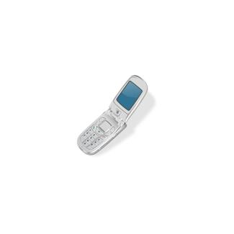

Educational Portal|Time & Cost Benefit
Section 1
Time and Cost Benefit
Section 2
Before
Time to reach School
Wait in a
Queue
Can she help me?
Section 3
Cost of Transportation
Section 4
After
Access through computer and Mobile
Section 5

Slide 10
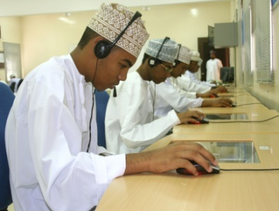
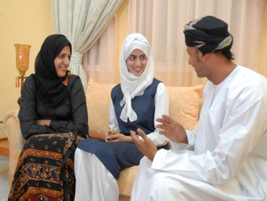
Educational Portal|Time & Cost Benefit
Minimal routine work for staffs, thus, better productivity and efficiency…
From Anywhere, At Anytime!
Thousands of parents REDUCE COST and TIME by avoiding going to the school physically.
Information can be accessed from ANYWHERE at ANYTIME through MULTIPLE E-CHANNELS.
Use e-Library and interactive virtual classroom FREE of COST.
SAVINGS for MINISTRY – AUTOMATED PROCESS ensured Savings from TIME and COST.
E-Learning facilitate students to minimize expenses on books etc…
24X7 access to services ensures better parent involvement…

Slide 11
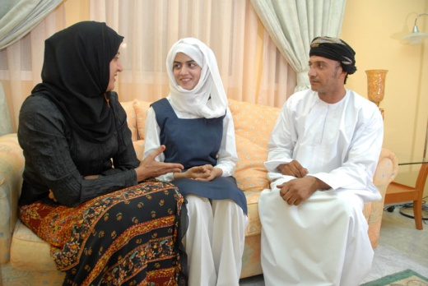
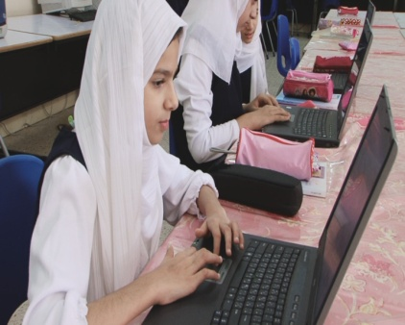
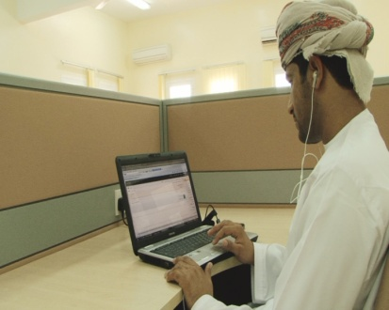
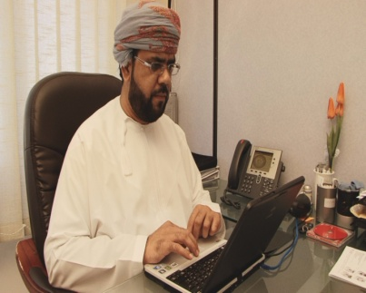
Online Services
Parents Services
Student transfers
Student registration
Parents Enquiries
Edit student data
Mobile services
School timetable
Fax services
Agenda
Email
Students Services
School timetable
Exam Timetable
Seat numbers for exams
Optional subject for grade eleven
Evaluation Report
Virtual Classroom
Email
Teachers Services
Students reports
Allocate students to activities
Forums
Chat services
Communicate with students through e -learning
Follow up students achievement
transfer
Employees Services
Vacations
Supervision
Training
e-file and CVs
attendance
Authorization for related services
e-correspondence
procurement
Email

Slide 12




Educational Portal|Security, Availability and Support
Section 1
Section 2
Authentication
Firewall
Parents
Section 3
Registration
Inquiries, Feedbacks & Complains
Student
User ID, Password
Support
Team
Section 4
MoE Services
Security
Section 5
Teacher

Slide 13

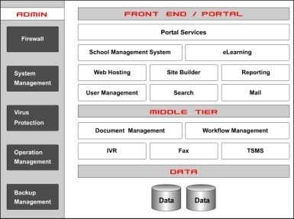
Educational Portal|Security, Availability and Support
Latest security appliances are deployed to protect data and mitigate risks
Security
The Educational portal:
Undergoes risk assessment and penetration test (externally & internally), vulnerability test, technical audit, performance audit and application code review on 6 months basis.
It is available on only authentication (HTTPS) and for remote management VPN over SSL.
Dedicated secure line.
Integrated solution cross-leveraging school management, eLearning etc.
Multi – access channels customer support…

Slide 14

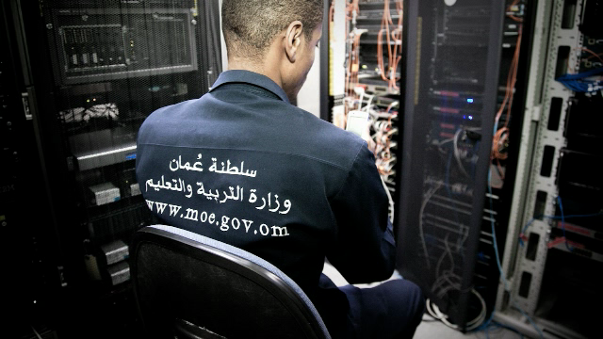
Educational Portal|Security, Availability and Support
Learning has never been so interesting…
Availability
The Educational portal:
Provides bi-lingual support with live casting of MoE news.
Support for viewers through search engine, FAQ and help, site map, contact us and downloadable newsletter facility.
Interactive voice recognition(IVR) for students with special needs (yet to be launched).
Continuous innovation to deliver better services……

Slide 15
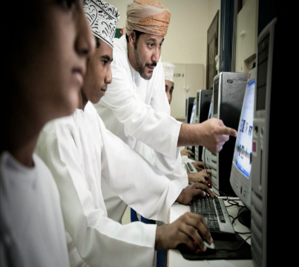
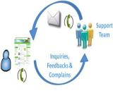

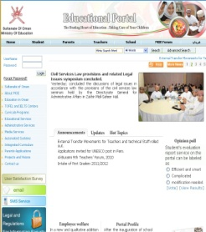

Educational Portal|Security, Availability and Support
Multi Channel –customer support: email, SMS, kiosk….
Customer Support
With Educational Portal:
Students/Parents can send their inquiries, feedbacks, complaints, and receive responses through their emails and subscribed mobile.
A call centre has been envisaged to provide anytime, anywhere support. The call centre will be set up in next 4 months time.
Feedback and complaints are periodically analyzed to ensure better quality of service within committed service levels.
Send your feedback / complaint @ www.moe.gov.om.....
A call centre will be set up for voice support 24X7…

Slide 16
The Projects’ Phases
2006
2008
2009
2013
2014
2016
First Phase
Second Phase
Third Phase
Better Education Planning
Administration Business Process
Financial Business Process
First phase
Second phase
Atomize all educational & administrative processes at schools
Build e-content
E-services for employees
Add new educational regions
Third phase
Develop the financial system
Integrate with government systems

Slide 17
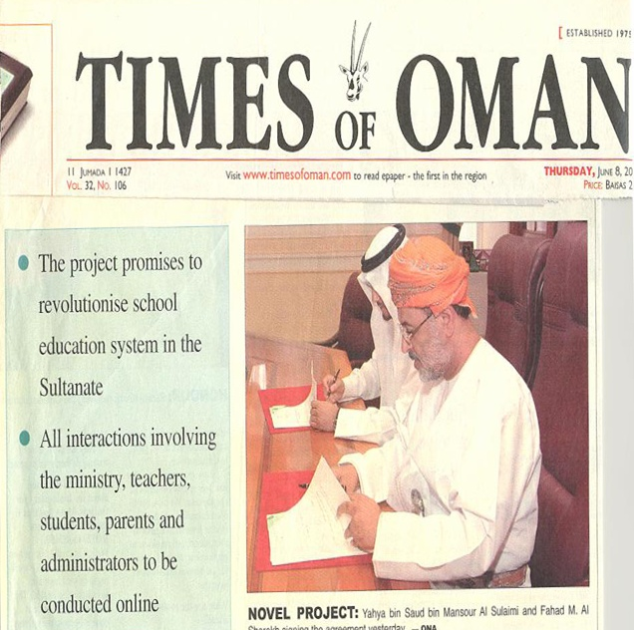
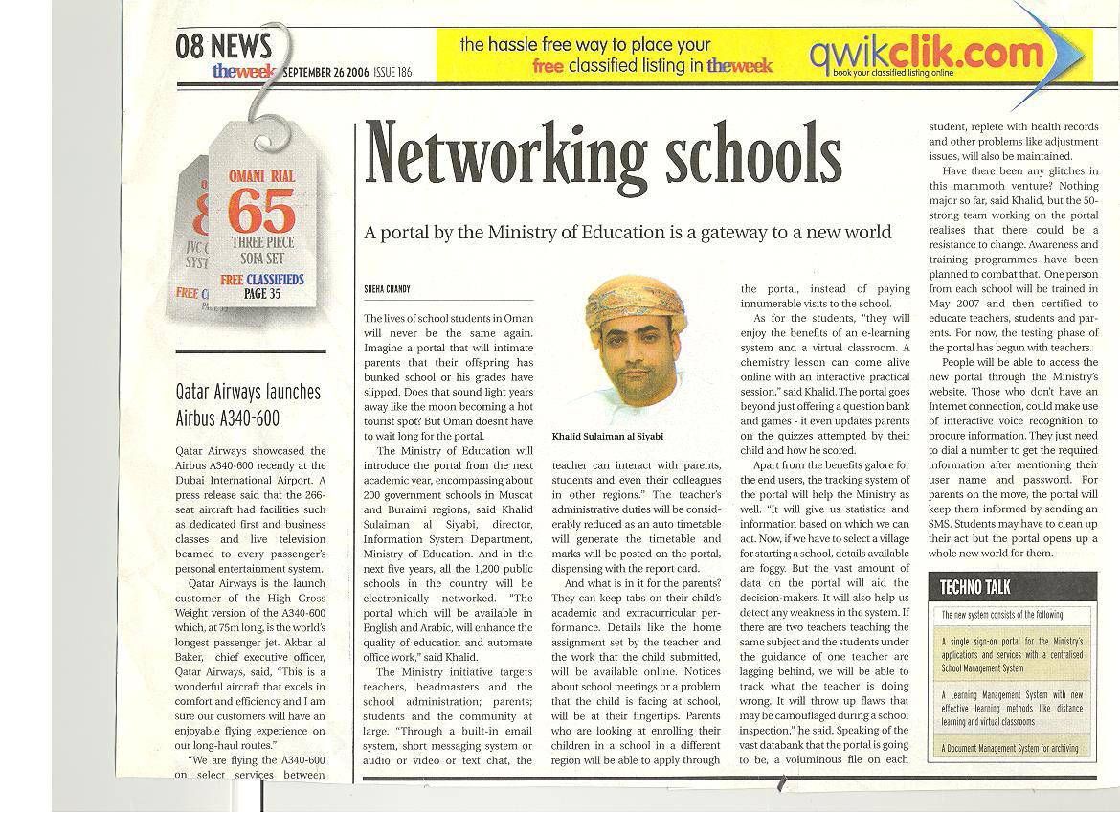
Educational Portal|Educational Portal & Society
Section 1
Section 2
Section 3
Section 4
Section 5

Slide 18


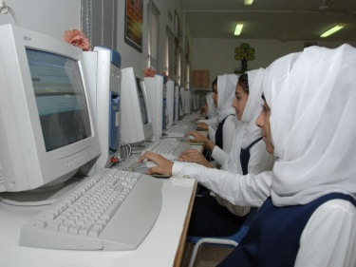
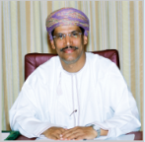
Educational Portal|Educational Portal & Society
Awareness Campaign
Awareness created through Media (Newspaper, TV, Radio and Awareness Brochures) and also by creating students guide….
The electronic educational portal links all components of the educational system using a group of programs and services through the use of the internet. The aim of the portal is to facilitate communication within the educational process and present it in an effective and attractive shape for teachers, students, parents and administrators. It also helps to facilitate administrative work within the ministry through a number of systems such as electronic requests and document archive etc.
World class educational infrastructure for the futures of Oman…
Mohammed bin Nasser Alksaibi, Secretary General, Ministry of National Economy

Slide 19
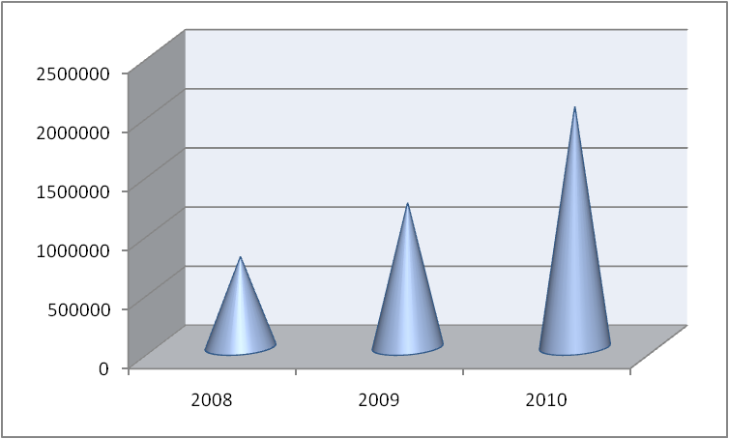
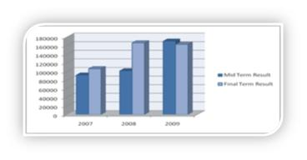

Educational Portal|Educational Portal & Society
More than 2 million hits in 2010. There has been constant growth in hits in the last two years.
A lot of services in the MoE portal are instantaneous…

Slide 20
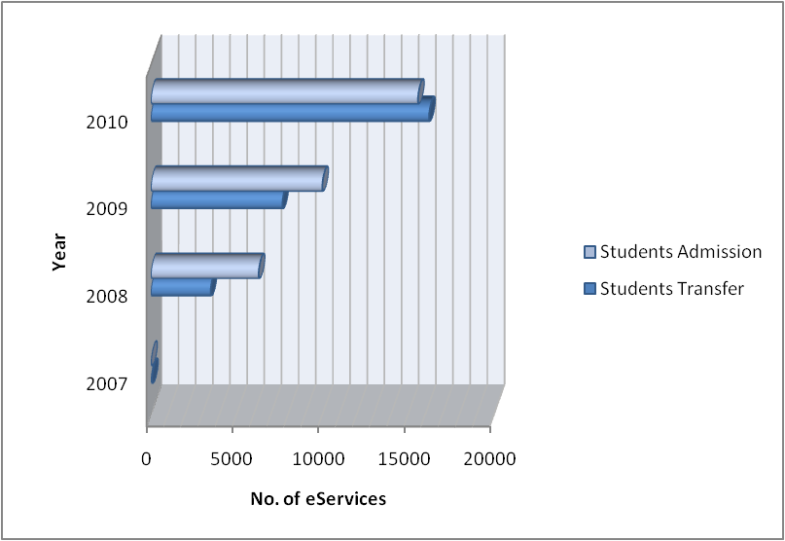
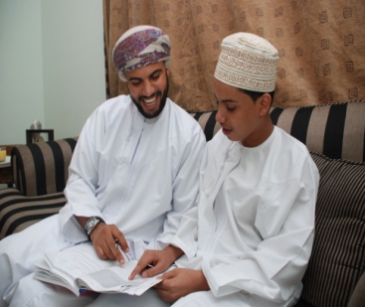
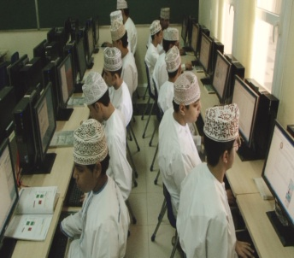
Educational Portal|Educational Portal & Society
The Educational portal has made a paradigm shift in Oman by nurturing the information society to a appreciable extent.
Involvement of parents has increased rapidly due to the E-Channel….
The month of January in 2011 has already recorded more than 100 thousand hits…

Slide 21


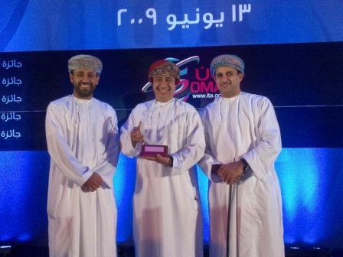

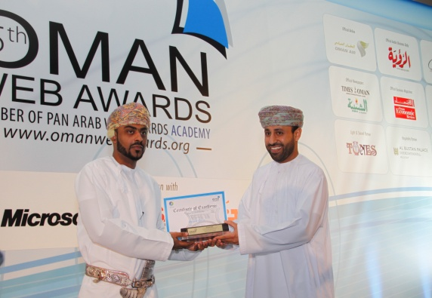

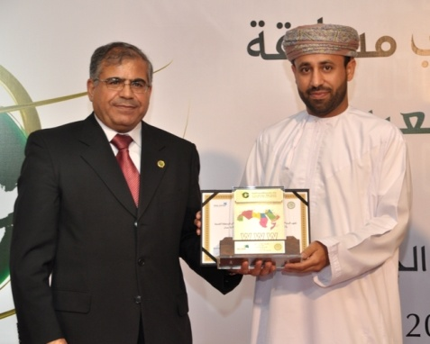
Educational Portal|Accolades
Section 1
Section 2
Section 3
Section 4
Section 5

Slide 22

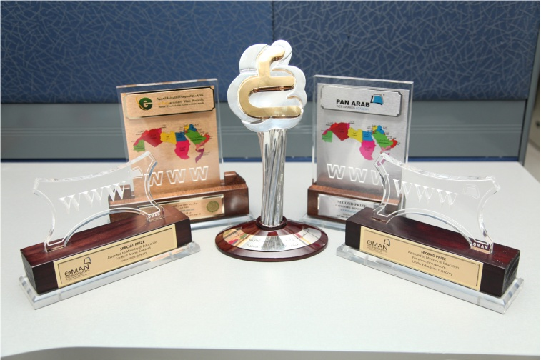


Educational Portal|Accolades
Awards
The Educational portal was awarded twice in 2007 for its rich website (Golden Award Best Website) and for the best educational site (e-Gold Award).
The Educational portal was awarded recently as First Place in the UNPSA 2011 in the category of improving the services delivery
Winner of Golden Award and e-Gold Award. ..
Winner of the PAN Arab Award….

Slide 23
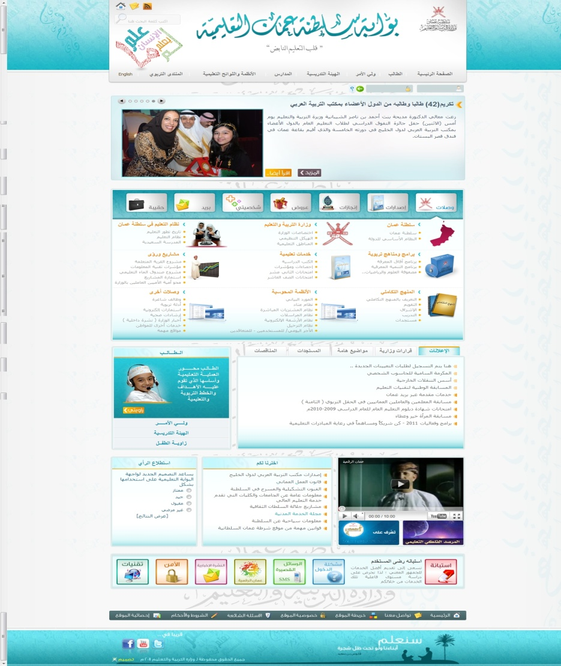
Thank you
The Official Educational Portal (English)
www.moe.gov.om
The Official Educational Portal (Arabic)
www.moe.gov.om

Slide 24
Thank you

